Slide 1
Managed Care Organization member resource information
for Community Care Hubs
Updated March 2026

Slide 2
Information on MCO Member Benefits including:
Apple Health member services by MCO plan
Member rewards + incentives available by MCO plan
Value Added Benefits by type
How to escalate member concerns or enrollee questions
How to access virtual care options by type, by MCO plan
Managed Care Plans expanded slides included:
Community Health Plan of Washington (CHPW)
Molina Healthcare of Washington
United Health Care of Washington

Slide 3
Index | Member Sites
Apple Health Benefits Booklets (MCO): https://www.hca.wa.gov/assets/free-or-low-cost/19-046.pdf
CHPW: https://www.chpw.org/member-center/
Coordinated Care: https://www.coordinatedcarehealth.com/members.html
Molina Healthcare of WA: https://www.molinahealthcare.com/members/wa/en-us/mem/medicaid/imc/physical-behavioral-health.aspx
WellPoint: https://www.wellpoint.com/wa/medicaid
United Healthcare: https://www.uhc.com/

Slide 4
How to Make a Referral to an MCO
MCO | How to Refer
CHPW | For Medicaid members, call 1-866-418-7004 (TTY 711) CareMgmtReferrals@chpw.org
Coordinated Care | For Medicaid members email caremanagement@coordinatedcarehealth.com or call 1-877-644-4613 (TTY 711) For Apple Health Core Connections (foster care) members email AHCCTeam@coordinatedcarehealth.com
Molina | Molina of WA CM Referral Form Molina of WA Pregnancy Referral Form
United Healthcare | For Medicaid members, call 1-877-542-8997 (TTY 711) wa_carecoordinationrequests@uhc.com
Wellpoint | Submit the Care Management referral form to: cmrefwash@wellpoint.com (physical health needs) wabhreferrals@wellpoint.com (adult behavioral health needs) wabhpeds@wellpoint.com (youth behavioral health needs)

Slide 5
CBWs: Include the following information in the email when sending a referral on behalf of a client:
  Your name and contact information
  Confirm you received consent from the client to send the referral
  Member’s name and date of birth
  ProviderOne number
  Member’s best contact number and way to contact or time to call
  Primary reason for referral

Slide 6
Slide for CCHs to add information and instruction for CBW reference

Slide 7
Community Health Plan of Washington

Slide 8
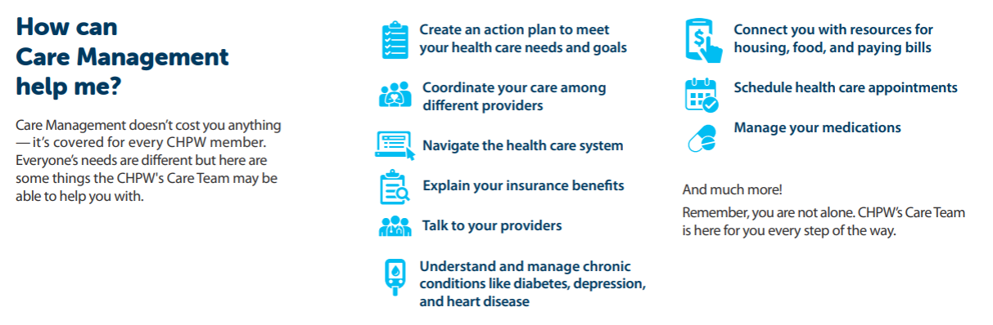
CHPW Care Management Overview

Slide 9
CHPW Care Management Teams
Medicaid Care Management
Telephonic and field-based Care Management for all Medicaid members
Medicare/DSNP Care Management
Telephonic Care Management for all Medicare and DSNP Members
Special Programs
Carceral Transitions
Patient Review and Coordination (PRC)*
Transitions of Care
Community Support Services
Field-Based Community Health Workers
Wellness and Chronic Conditions
Maternal Child Health
Diabetes Care Program
Health Homes
Health Risk Assessment Team
*PRC is a Medicaid health and safety program authorized by federal Medicaid law that coordinates care and ensures clients enrolled in PRC use services appropriately and in accordance with state Medicaid agency rules and policies. PRC allows the state Medicaid agency to restrict clients to certain providers.

Slide 10
CHPW Customer Service
Please also see the Virtual Care slides for virtual healthcare options for CHPW members.
Medicaid/Behavioral Health Services Only (BHSO): The Customer Service State Programs hours of operation are 8:00 am to 5:00 pm Monday through Friday, Pacific Time. Members, providers, government entities, and others may call the Customer Service phone number at 1-800-440-1561 and reach a Customer Service Representative who is trained to assist with any inquiry that is received. Hearing and speech impaired may dial 711. The Customer Service State Programs Department observes Washington State holidays and is typically closed on those days. Interpreter services will be provided, if necessary, and will be provided free of charge.
Medicare: CHPW’s Medicare Customer Service Representatives are available from 8:00 am to 8:00 pm, seven days a week during Open Enrollment (October 1 to March 31) and from 8:00 am to 8:00 pm Monday through Friday the rest of the year (April 1 to September 30), at phone number 1-800-942-0247. Hearing and speech impaired may dial 711. The Customer Service Representative is trained to assist with any inquiry that is received. The Medicare Customer Service Department is typically open on Washington State holidays except for those closures allowed by CMS. Interpreter services will be provided, if necessary, and will be provided free of charge.
Cascade Select: Community Health Network of Washington’s Cascade Select hours of operation are 8:00 am to 5:00 pm Monday through Friday, Pacific Time. Members, providers, government entities, and others may call the Customer Service phone number at 1-800-907-1906 and reach a Customer Service Representative who is trained to assist with any inquiry received. Hearing and speech impaired may dial 711. The Customer Service Department observes Washington State holidays and is typically closed on those days. Interpreter services will be provided, if necessary, and will be provided free of charge.
AFTER BUSINESS HOURS: The phone system will automatically queue any after-hour voicemails the following business day to team leads so callbacks can be made.

Slide 11


CHPW Virtual Care
When you can’t wait to see your regular doctor, a specialist or need support right away, CHPW Virtual Care offer urgent care, therapy, psychiatry, and dermatology services from the comfort of your home
With CHPW Virtual Care
See a provider fast – No travel or long wait times
Specialist visit available – Dermatology, talk therapy, psychiatry
Urgent Care – On-demand care for illness, injury,
or prescriptions
The new and improved CHPW Virtual Care mobile app is now live! You can find it on Google Play or the Apple App Store.
The cost or copay is the same as an in-person visit for each service and varies by plan. Check plan documents for details.
NEW in 2026: $0 copay for Urgent Virtual Care
Visit our website to learn more at: individualandfamily.chpw.org/member-center/virtual-care/
11

Slide 12
CHPW Virtual Care
CHPW Members have access to MDLive – A telehealth care option directly from their phone or PC! MDLive includes access to Virtual Urgent Care, Therapy, Psychiatry, and Dermatology anywhere in the US. Members can download the app from any Android or Apple app store.
For Mental Health and Behavioral Health needs, members can access Brightside – Virtual Care. Members can begin to access Brightside by completing an assessment at: Brightside
For Medically Assisted Treatment for substance use disorders, members can access Bouldercare. This includes Virtual clinician visits through a secure, private app on the member’s phone, On-demand visits in the app’s “Pop-In Clinic” to get a prescription, and prescriptions for Suboxone and other medication for SUD treatment.
Charlie Health is available for members 11-50 with Mental Health, Substance Use, and Eating Disorder treatment needs. Charlie Health offers virtual intensive programs from home. These outpatient programs combine individual therapy, family therapy, and tailored group therapy sessions. Psychiatry and medication management are included as needed to support healing.
NURSE ADVICE LINE: Members can also reach the 24/7 Nurse Advice Line for CHPW by calling 1-866-418-2920 (TTY: 711) for free advice on what kind of care a member may need.
Digital Navigation is available to all members through LinkToCare – this includes education on utilizing computers and smartphones, accessing and setting up applications, and connection to programs for phones or low-cost internet services.

Slide 13
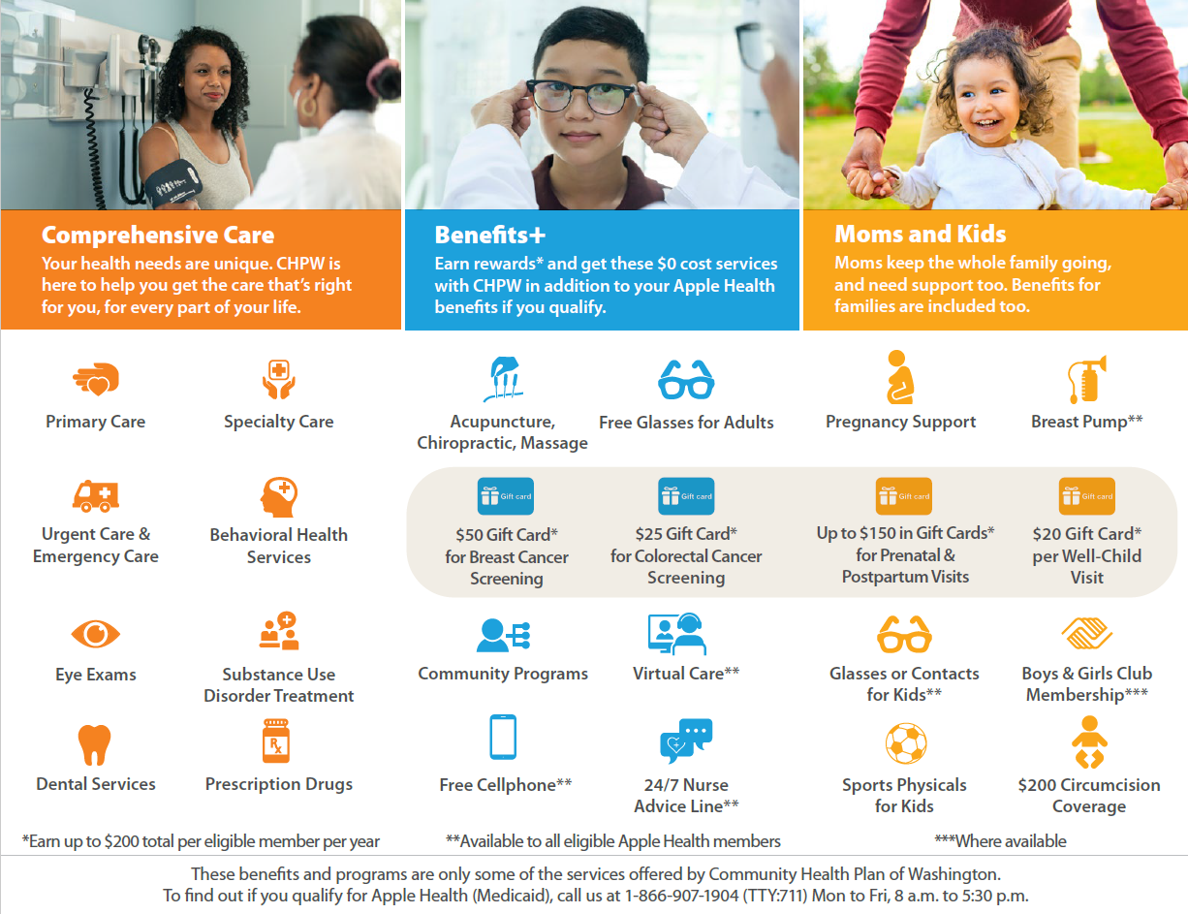
CHPW Apple Health
Staying healthy is an important goal for you and your family. CHPW Apple Health members get extra programs and benefits that cost $0.
See more at: chpw.org/benefitsplus

Slide 14
CHPW MemberFirst™ Rewards
Earn rewards for preventive care
CHPW rewards our adult members for looking after their own health.
Breast Cancer Screening
Apple Health
Cascade Select
Medicare
$50
Gift card rewards for completing preventive health screenings or tests
Claim rewards online
Choose gift cards from Amazon, Safeway/ Albertsons, or Target.
Colorectal Cancer Screening
Apple Health
Cascade Select
Medicare
$25
Cervical Cancer Screening
Apple Health
Cascade Select
Medicare
$50

Slide 15
Escalating Concerns
Member or Process concerns can and should be brought to CHPW’s attention when a member is unsatisfied with a service they have received, have questions about their benefits, or feel they need additional services to what they have been connected to previously.
To escalate member or process concerns, please contact CHPW using the following:
  https://www.chpw.org/member-center/
  CHPW Member services: 800-400-1561

Slide 16

Coordinated Care

Slide 17
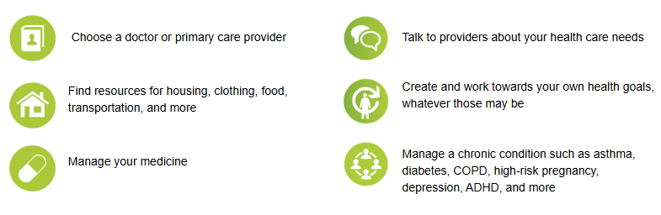
Life is complicated. Your healthcare doesn’t have to be.
Coordinated Care offers confidential care management at no-cost to all our members. Care management helps you access care, understand your benefits, and get connected to services. Coordinated Care’s care management team is made up of qualified social workers, nurses, and specialists.

Slide 18
How to Contact Coordinated Care
Contact Coordinated Care to get personalized help managing benefits, resources, and health conditions through programs like:
  Care Management
  Disease Management
  Community Health Workers
To get connected:
  For Apple Health members send an email to caremanagement@coordinatedcarehealth.com or call 1-877-644-4613
  For Apple Health Core Connections (Foster Care) members send an email to AHCCTeam@coordinatedcarehealth.com
Include in the referral:
  Member’s name and date of birth
  ProviderOne number
  Who is making the referral and preferred contact
  Member’s best contact number and way to contact or time to call
  Primary reason for referral
For process/workflow concerns, email: caremanagement@coordinatedcarehealth.com

Slide 19
Coordinated Care: Escalating Member Concerns
Members and their authorized representatives have the right to file a complaint if they are unhappy with the quality of care they have received or if they feel that their rights as a health plan member have been affected. Members also have the right to appeal a decision made by Coordinated Care. Complaints will be reviewed and resolved within 45 calendar days.
For more information, visit our website.
Members may file a complaint, also known as a grievance by phone, mail or fax. If mailing or faxing a complaint, members can use the grievance form (PDF) or write a letter.
  Phone: 1-877-644-4613
  Fax: 1-877-212-6668
  Mail:
    Coordinated Care
    Attn: Grievance Department
    1145 Broadway, Suite 700
    Tacoma, WA 98402

Slide 20

Molina Healthcare of Washington

Slide 21
Molina Healthcare of Washington

Slide 22
Molina Healthcare of Washington
Serving Medicaid enrollees in all Washington Counties
Reference Materials for the following Programs:
Care Management services
Member Services
Nurse Advise Line
Member Value Added Benefits
Telehealth Services
Member Rewards Program
Notes:
Laura

Slide 23



Care Management Programs
Quick Referral links to request Care Management services:
Molina of WA CM Referral Form
Molina of WA Pregnancy Referral Form
Contact information for Molina:
Nurse Advise Line
Member Services

Slide 24
What to include in a Care Management referral,
Care Management Referral Triggers
Refer a member to a Managed Care - Case Manager when:
Members have complex clinical or behavioral health needs
Members have been hospitalized or visited the ED and have ongoing clinical care issues
Members have increasing health care needs and needs are more appropriate for clinical support.
Member requests for MCO Care Manager
Members are identified as Health Home eligible. Verify if the member is working with a HH care coordinator.
Members need assistance coordinating care among health care providers
Members need assistance coordinating benefits among Medicaid programs
  Who is making the referral and preferred contact
  Did referrer obtain member’s consent?
  Member’s name and date of birth
  ProviderOne number
  Member’s best contact number and way to contact or time to call
  Primary reason for referral
Notes:
Laura

Slide 25
Molina Care Management Programs
Care Coordination and Case Management
Living with health problems and managing them can be hard. Molina offers special services for members who need extra help. Molina staff can help you:
Better understand your health issues
Schedule provider visits and tests
Find community services near you such as food banks, clothing resources and housing agencies
Get transportation assistance
Care for chronic conditions like asthma, depression, diabetes and heart disease
Specialized Care Management Programs
Autism/ABA Therapy
  Call: (509)-321-1365 (TTY:711)
  Email: ABA@molinahealthcare.com
Bariatric Surgery
  Call: (425)-330-7467 (TTY:711)
  Email: mhw-bariatric-program@Molinahealthcare.com
Health Services for Children with Complex Health Needs;
  Children’s Long-Term Inpatient and WRAP with Intensive Services
  Fax: (800) 767-7188
  Email: mhwcmreferral@molinahealthcare.com
LGBTQIA+ Gender Affirming Care Navigation
  Fax: (800) 767-7188
  Email: mhwcmreferral@molinahealthcare.com
Maternity Support Care Management
  Call: (800) 869-7165
  Email: mhwcmreferral@molinahealthcare.com

Slide 26
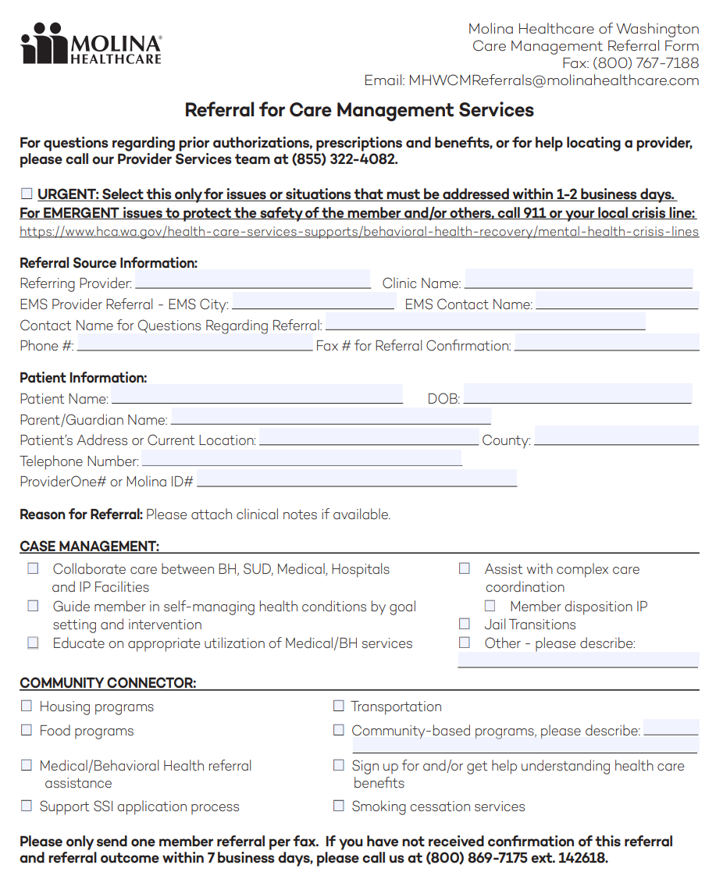
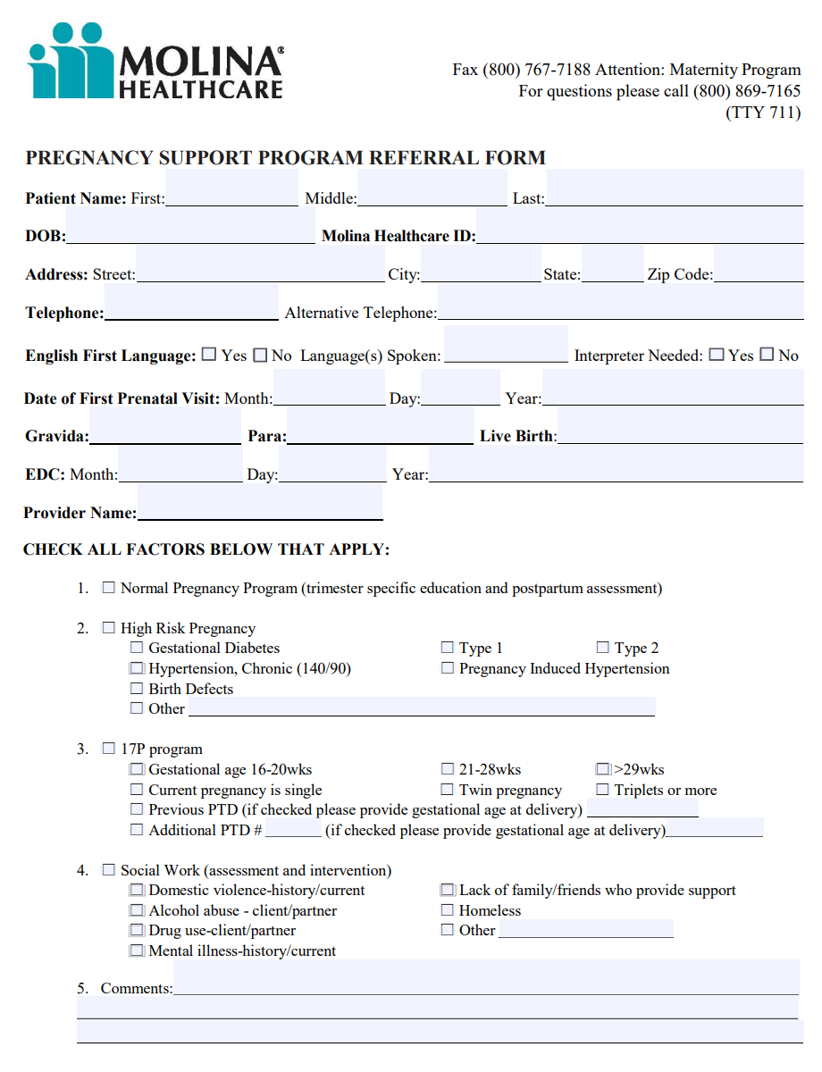

Molina CM Referral forms
Molina of WA CM Referral Form
Molina of WA Pregnancy Referral Form

Slide 27

Molina Key Contacts
Molina Member Services
(800) 869-7165, TTY 711
MyMolina.com
MolinaHealthcare.com/WA
We have staff who speak Spanish, and we offer translation services.
Molina Virtual Care (through Teladoc), available 24/7
(844) 870-6821, TTY 711
teladoc.com/molinawa
Nurse Advice Line, available 24/7
Call anytime, day or night, if you are experiencing symptoms or need health care information. Registered nursed are available anytime day or night, to assess symptoms and help make good health care decisions.
English and other languages
(888) 275-8750, TTY 711
Spanish
(866) 648-3537, TTY 711
Transportation
Non-Urgent Transportation for Medical and Behavioral Health Appointments
Call your local transportation broker to learn more about transportation services at: hca.wa.gov/transportation-help

Slide 28

When to refer an Enrollee to Molina Member Services
Contact Molina Member Service for help with:
    Update contact information
    Connecting with a Care Provider
    Replace lost ID cards and verify health plan eligibility
    Questions about claims, coverage details
    Authorization for specialized services,
    Access support services with:
      transportation,
      interpreter services or
      specialized care coordination
    File complaints/ grievances, appeals, report fraud

Slide 29

How to escalate process and enrollee concerns
For all process and enrollee concerns that are not addressed in the previous slides please contact:
Rachel Vanderlinda RN CCM at: Rachel.Vanderlinda@MolinaHealthcare.com
For Medical or Behavioral Health Emergencies call 911

Slide 30

Value Added Benefits
VAB Value Added Benefits (VABs) are additional supports not covered by Apple Health offered by an MCO to their members to improve their health and wellbeing.
Link to Molina VAB:
https://www.molinahealthcare.com/members/wa/en-us/mem/medicaid/imc/covered/value-added-benefits.aspx

Slide 31

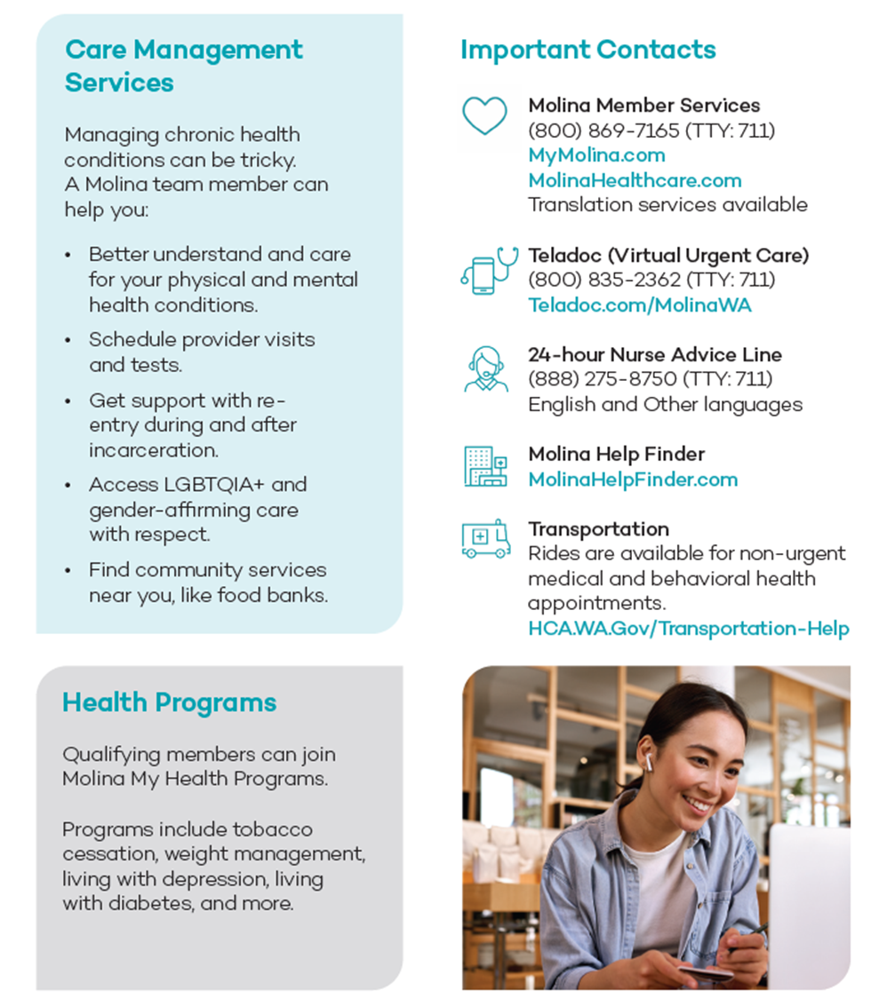

Value Added Benefits
Learn more at:
MeetMolinaWA.com

Slide 32
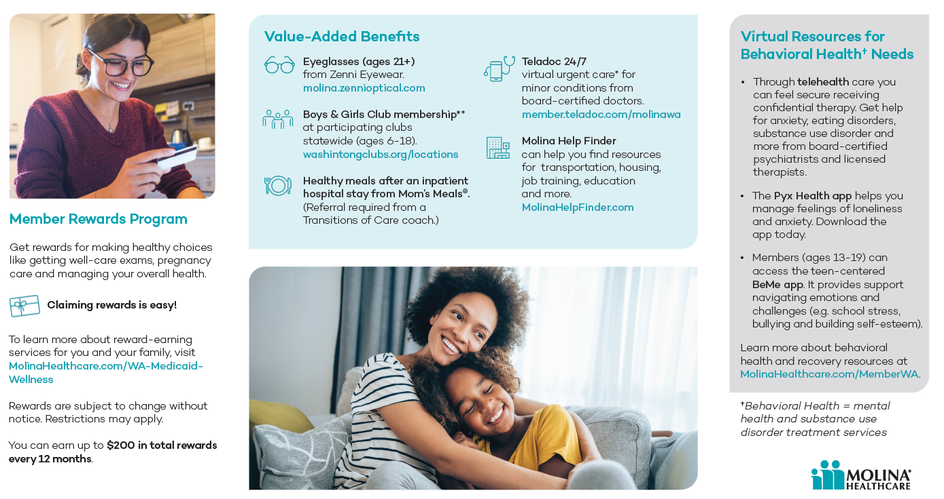

Slide 33

What is a Member Reward
People enrolled in a Managed Care Plan can earn rewards (usually in the form of gift cards) for completing important wellness visits and screenings. These awards are a nice way to reward enrollees for looking after their own health.

Slide 34

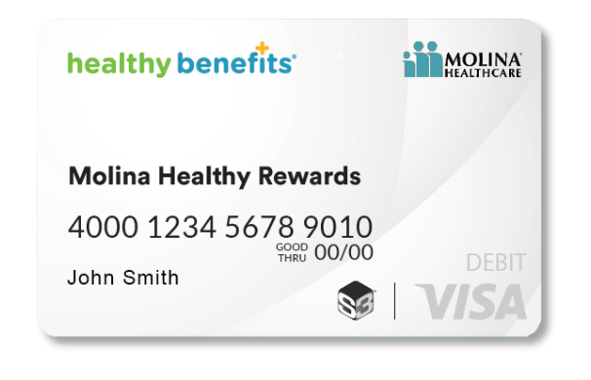
Molina Member Incentives
Molina Healthy Rewards
Notes:
Molina Medicaid members can earn rewards for completing important wellness visits and screenings. The members will receive a reloadable reward card and use to shop in person at participating retailers or online at Walmart.com. Members can use the rewards for other purposes such as bill pay, gas (pay-at-pump only) or pet supplies. For details on where they can spend your rewards, see the Store Finder flyer.
Shop in person at participating retailers or online at Walmart.com. You may also use your rewards for other purposes such as bill pay, gas (pay-at-pump only) or pet supplies. For details on where you can spend your rewards, see our Store Finder flyer.

Slide 35
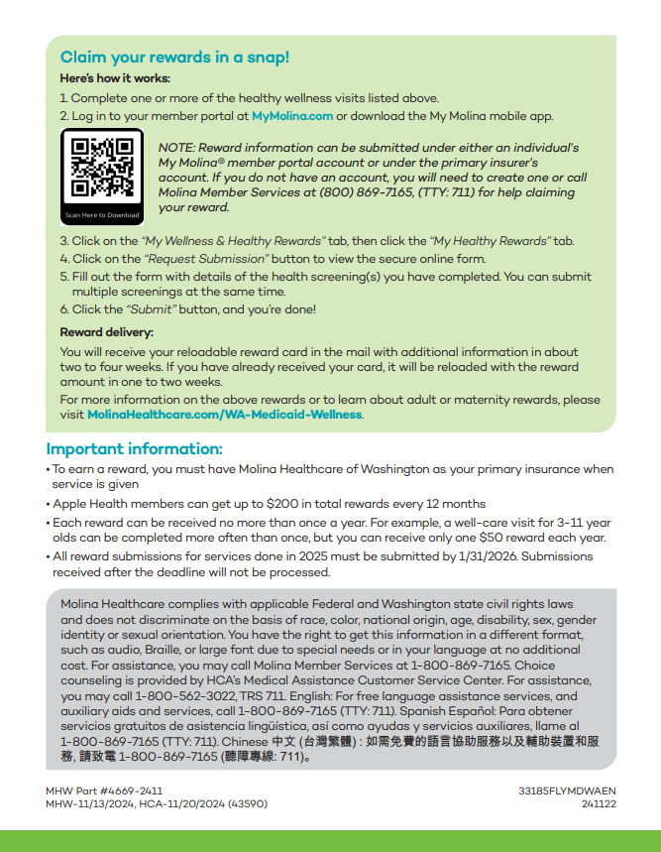
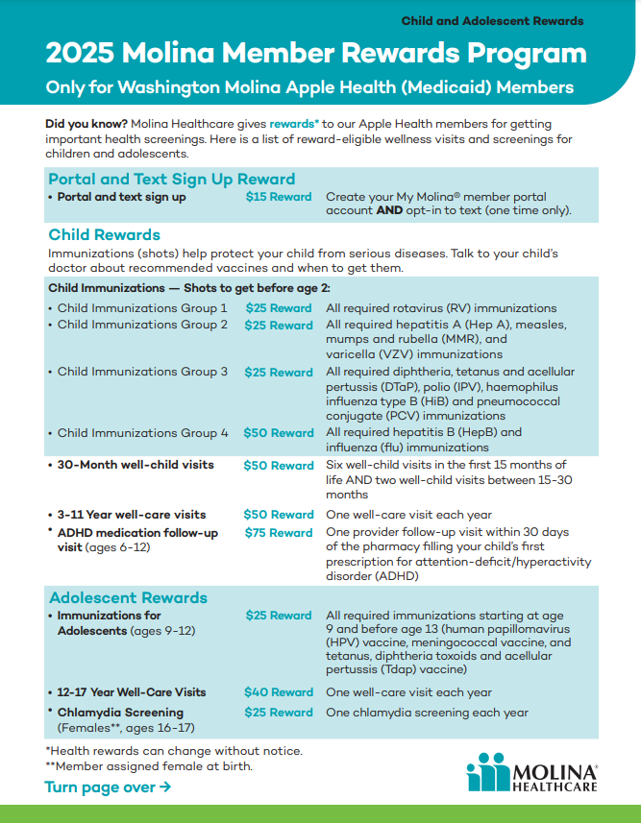


Updated redemption process
2025 Molina Member Rewards for kids and teens
Updated reward amounts
Notes:
Important information:
To earn a reward, you must have Molina Healthcare of Washington as your primary insurance when service is given.
Apple Health members can get up to $200 in total rewards every 12 months.
Each reward can be received no more than once a year. For example, a diabetes HbA1c test can be completed every 3-6 months, but you can receive only one $35 reward each year.
All reward submissions for services done in 2025 must be submitted by 1/31/2026. Submissions received after the deadline will not be processed

Slide 36
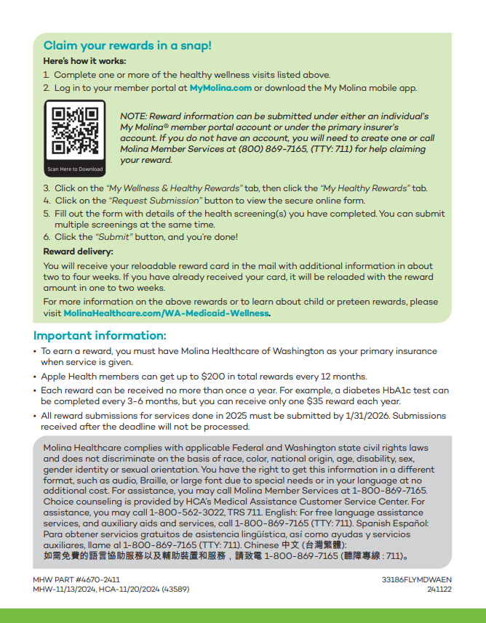
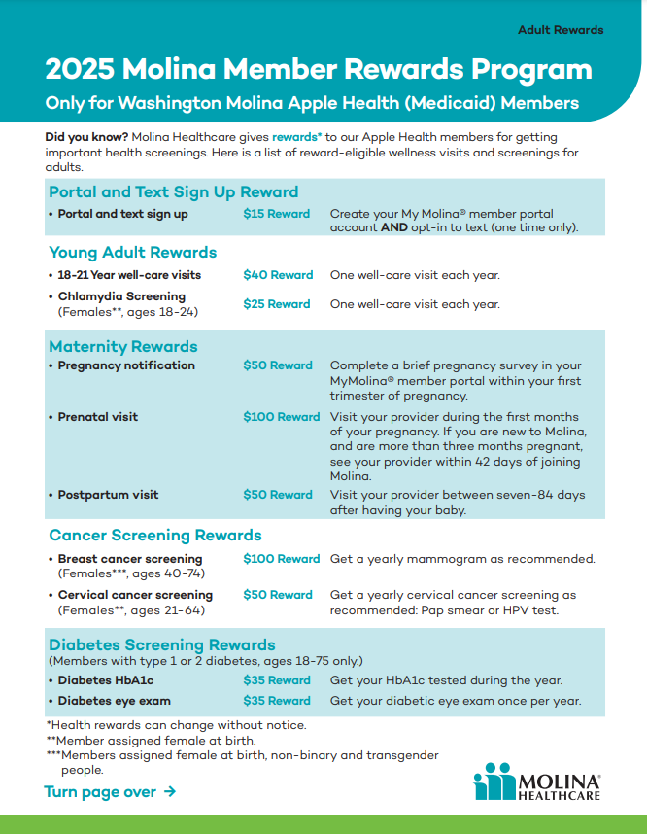

Updated redemption process
NEW
reward
2025 Molina Member Rewards for Adults
Notes:
Here's the list of member rewards for adults. Members can attest via the member portal, mobile app, or calling the members services department.
To earn a reward(s), you must have Molina Healthcare of Washington as your primary insurance when service is given.
Apple Health members can get up to $200 in total rewards every 12 months.
Each reward can be received no more than once a year. For example, a diabetes HbA1c test can be completed every 3-6 months, but you can receive only one $35 reward each year.
All reward submissions for services done in 2025 must be submitted by 1/31/2026. Submissions received after the deadline will not be processed.
For more info: Apple Health (Medicaid) Member Rewards | Molina Healthcare of Washington

Slide 37

What is Telehealth
Telehealth lets you see your healthcare provider and access health care services remotely by using computers, tablets, or phones
Apple Health members can access telehealth via:
  Their regular PCP or specialist providers they see in person, if the provider offers telehealth, OR
  Members can access telehealth through their MCO provided resources. All the MCOs offer telehealth resources and networks for members that need services like urgent care, dermatology or behavioral health. MCOs also have 24/7 nurse advice lines for their members.

Slide 38
Molina Telehealth Resources
Telehealth Provider | Services | Age Range Served | How to make a Referral
Bicycle Health | Counseling and Medication for Opioid Use Disorders | 18+ | Call: (844) 943-2514 Or enroll online at bicyclehealth.com
Boulder | Counseling and Medication for Opioid Use Disorders Counseling and Medication for Alcohol Use Disorders | 18+ | Call: (888)316-0451 Members can enroll directly at boulder.care/getstarted Members can call: (888) 608-0836
Teladoc 24/7 Molina Virtual Care | General medical care 24/7, including self-guided digital programs and counseling, and medication management for mental well-being. | 18+ | Call (844)870-6821, TTY 711 teladochealth.com/benefits/molina/wa
Groups Recover Together | Virtual and in person group-based treatment for opioid use disorder. Members attend weekly group therapy sessions and receive personalized care, including medication for opioid use disorder. | 18+ | In-person group sessions currently available in Kennewick area Online groups call: (888) 858-1723 (TYY:711)

Slide 39

Molina Mental Health App Resources
App Related Provider | Services | Age Range Served | How to make a Referral
BeMe App | Mental health wellness app built for teens. Helps teens navigate emotions, develop health habits, improve relationships and communication, and build serf-esteem. Live coaching and crisis support are available if needed. | 13-19 | Molina Members can search BeMe app in the Apple store or Google Play store

Slide 40

United Health Care

Slide 41
Maternity support
(NEW Jan. 1, 2024) Car seat at no cost. UnitedHealthcare Community Plan Apple Health (Medicaid) enrolled members can choose between 2 car seat models of equal value to be shipped directly to them. The car seat restraint system meets all applicable federal motor vehicle safety standards.
Gift cards and baby item rewards.
Hospital-grade electric breast pump.
Prenatal vitamins.
Access community resources: Get help finding a delivery doctor, midwife or specialist.
Babyscripts: educational content, appointment reminders and helpful gift card reward for enrollments ($75), one prenatal appointment ($50) and one postpartum appointment ($25). Download the Babyscripts™ myJourney app through the App Store or Google Play.
Healthy First Steps Program: Case management by RN and community health workers prenatal to 1 year post-partum. Learn more
(NEW Nov. 2023) Mom’s Meals: Home-delivered meals for two week period to enrolled eligible birthing person and up to four additional household members. To learn more, you can enroll in Healthy First Steps by calling 1-800-599-5985.
Quit for Life: Smoking cessation support during pregnancy. Learn more
Text4Baby: Education and support. To sign up, you can text BABY to 511411 for messages in English and BEBE to 511411 for messages in Spanish.
Wellhop Program: Connect with other moms for support during your pregnancy and beyond. Learn more

Slide 42
Food security & Housing support
Food security
(NEW Nov. 2023) Mom’s Meals: Home-delivered meals for two week period to enrolled eligible birthing person and up to four additional household members.
To learn more, you can enroll in Healthy First Steps by calling 1-800-599-5985.
Members dealing with food insecurities can receive help with resources provided by community health workers, Member Services, and case managers in addition to the use of the Findhelp tool.
Housing Support
Help with housing agency resources provided by community health workers, Member Services and case managers in addition to use of the Findhelp tool.

Slide 43
Understanding Critical Incidents
A Critical Incident is any actual or alleged event or situation that creates a significant risk of substantial or serious harm to the physical, mental health, safety, or well-being of a member.
Critical Incidents include but are not limited to: abuse, neglect, exploitation, death, severely adverse medical outcomes, homicide, attempted homicide, arson, kidnapping, or any event likely to attract media coverage
MCOs are required to report critical incidents within one business day of becoming aware of the incident
When a Critical Incident occurs, use the HCA form and follow instructions on the form
If a Community Care Hub is aware of a critical incident, per the agreed upon Statement of Work, they will report it to the MCO consistent with both MCO and CCH policies

Slide 44
UHC Contacts
Member Services: 1-877-542-8997 TTY 711,
  M-F 8am-5pm PST
Medicaid 24-hr nurse line: 1-877-543-3409
Dr. Chat: UHCDoctorChat.com
  For members with internet access who are 13 years old or older. Member will need an email address and member ID to register.
Notes:
Terry Lee

Slide 45
UHC Escalations
For member appeals or grievance please see UHC Member Request Form:
  UnitedHealthcare member service request form
Notes:
Terry Lee

Slide 46
Telehealth resources (virtual care)
Telehealth through contracted providers.
BoulderCare: Telehealth solution for members looking for addiction treatment. Learn more
Bright Heart Health: 24/7 substance use disorder phone line. For more information, call 1-800-892-2695 or visit brighthearthealth.com
Charlie Health: Personalized intensive outpatient program for youth. For more information, call 1-866-508-7084 or visit charliehealth.com
Eleanor Health: Help coordinating physical health through care managers and services for long-term mental health needs. For more information, visit eleanorhealth.com
UHC Doctor Chat: Find more information by downloading the UHC Doctor Chat app at Google Play or the App Store or visiting UHCDoctorChat.com
  On-demand, ongoing access to a real doctor. Anywhere, anytime, at no cost to you.
  Get answers, treatment and prescriptions.
Complete a well-child visit.

Slide 47
Additional services
Transition support for jail/detention
  Members may receive duffel bags containing essentials upon leaving an incarcerated setting in addition to care coordination continued services.
Fitness/healthy lifestyles
  Members can receive help through community health workers, Member Services, case managers, and on-staff Registered Nurses RNs) in addition to use of the Findhelp tool.
  Dedicated subject matter expert RN for those with bariatric conditions. For more information, call Member Services at 1-877-542-8997 and indicate you wish to speak to a case manager.

Slide 48
Kids activities/clubs
Life transition support
Sports physical through your Primary Care Provider.
Boys & Girls Club membership for 6-18 years old.
  Memberships grant access to all programs and benefits — you can call your local Boys & Girls Club to learn more.
  This program is offered at all Boys & Girls Clubs, with locations across various Washington counties.
On My Way (OMW) program: Helps prepare youth members to reach their housing, employment, and financial management needs for the future. Learn more
Location-based services when available.
Members may receive duffel bags containing essentials upon leaving an incarcerated setting in addition to care coordination continued services.

Slide 49

Wellpoint Washington

Slide 50
Wellpoint Case Management Referrals
Physical Health Case Management referrals:
Physical Health referrals can be sent to: cmrefwash@wellpoint.com
Behavioral Health Case Management referrals:
Adult Behavioral Health referrals can be sent to: wabhreferrals@wellpoint.com
Pediatric Behavioral Health referrals can be sent to: wabhpeds@wellpoint.com
Wellpoint recommends utilizing the case management referral form for referrals to Physical and Behavioral Health for expeditious referrals: https://www.provider.wellpoint.com/docs/gpp/WA_WLP_CAID_CaseManagementReferralForm.pdf?v=202406171528
Additional information regarding case management programs are available on our website: https://www.provider.wellpoint.com/washington-provider/patient-care/case-management

Slide 51

Wellpoint 24/7 Member Care Services
Live Health Online – 24/7 Online urgent care for Physical or Behavioral health needs.
  https://livehealthonline.com
24-hour Nurse Line- Registered nurses available to talk with members about their health concerns
  800-424-8814 (toll free)

Slide 52
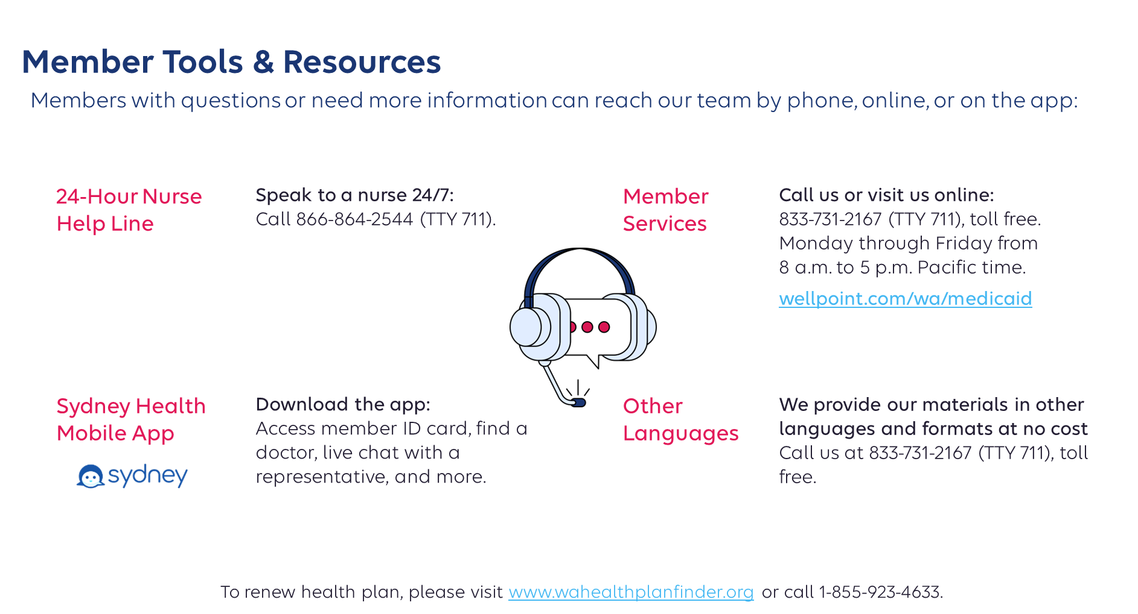


Slide 53

Escalations
Members can direct any concerns or questions to our Member Services phone line.
Member services will direct the member to the grievance department when appropriate.
Member Services Phone Line
  833-731-2167 (TTY 711)

Slide 54



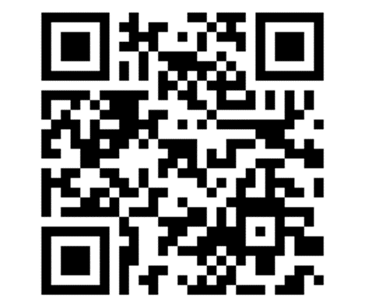


833-731-2167 (TTY 711)
wellpoint.com/wa/medicaid
Community Resource Link
  A tool to help find jobs, food, housing, & other services
wellpoint.findhelp.com
facebook.com/wellpointinc
twitter.com/wellpoint
Wellpoint – YouTube
linkedin.com/company/wellpoint

